Slide 1

Handelsbankens Microsoftdag 2021
October, 2021

Slide 2
Using Azure Machine Learning SDK to run heavy scripts on the cloud
Daniel Labbe

Slide 3





Daniel Labbe
Sr. Customer Engineer, Data & AI domain @ Microsoft
Master Student @ The University of Edinburgh
Teacher Assistant @ Udemy
Data Scientist
23+ years of experience in data related roles
Azure Data Scientist Associate, Azure AI Engineer Associate
8+ years dealing with Data Science
15,000+ questions answered in courses (400,000+ students)
Presented workshops in Data Science, Python, ML & AI
Engaged in StackOverflow and Kaggle
linkedin.com/in/daniellabbe

Slide 4




Session Objectives
Discuss the elasticity of cloud solutions
Discuss the flexibility of Azure Machine Learning
Discuss the convenience of local SDKs

Slide 5



Motivations
Heavy workloads might not be suited for your local Infrastructure
Time consuming
Tech dependent – new tech demands new hardware
Demands upfront investments
Limits the capacity of experimentation
Azure Machine Learning workspace is virtually free*
Adjacent resources have costs
Storage Account, Key Vault, Apps Insights have marginal costs
Computes can be expensive, but pay as you go
Azure Machine Learning can handle more than ML Workloads
AML is flexible to different maturity level
AML can handle well hybrid architectures for on-prem/on-cloud environments
AML can run scripts, not only training scripts

Slide 6



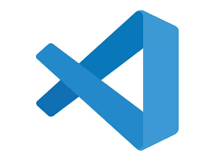


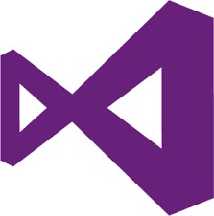





Solution Overview
on prem
on Azure
Python env
Install AML SDK
AML Workspace
Create AML Workspace
Create Remote Compute
Provision cloud resources using code (infra-as-code)
Run previously created scripts on remote computes
Turn off or auto scale the compute resources
Other IDE / technology
Prepare the Execution
Run
Consume outputs
Previously created script
Turn off or setup auto scale

Slide 7

Monte Carlo Simulations
Monte Carlo simulations are used to model the probability of different outcomes in a process that cannot easily be predicted due to the intervention of random variables. It is a technique used to understand the impact of risk and uncertainty in prediction and forecasting models.

Slide 8
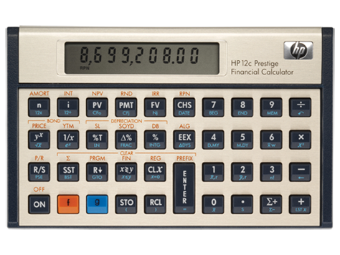
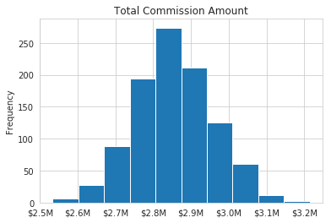
Monte Carlo Simulations
Pythonic implementation
Meaning that inside the “previously created script” to run, there will be no parallelization in the demo
Sales Rep Commission
The demo considered a simplistic use case of the Monte Carlo simulations focusing on the execution, not on the implementation
Statistical Output Interpretation
In this example, the uncertainty experimented is the number of sales to compute commissions, expecting a normally distributed outcome with the range of +/- 2 std covering 95% of the possibilities
Monte Carlo Simulation with Python - Practical Business Python (pbpython.com)

Slide 9
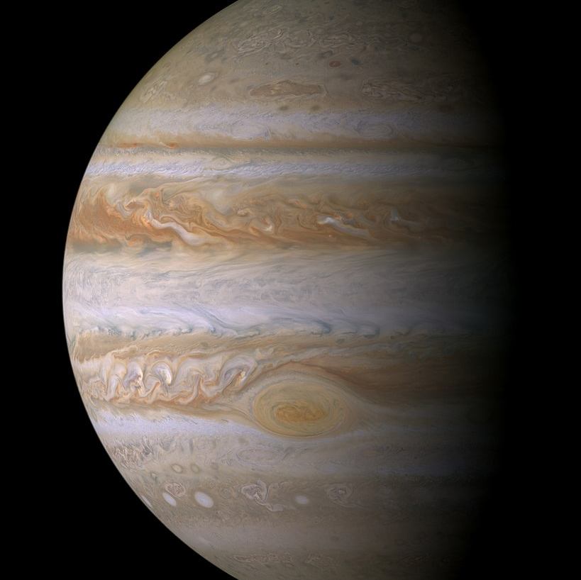
Demo
Using a local Jupyter instance to start a set of Monte Carlo simulations on Azure via AML SDK

Slide 10

Benchmark
Scalling from 10¹ to 10⁶ simulations in different compute sizes and prices for a parallelized implementation in R

Slide 11



Compute Sizes and Prices
E series for memory optimized
F series for compute optimized
D series for general purpose workload
N series for GPU optimized
Local PC
4 cores,16 GB RAM
Price: €0.00/hour *
DS3 V2
4 cores, 16 GB RAM
Price: €0.23/hour
(€167/month)
F16s V2
16 cores, 32 GB RAM
Price: €0.65/hour
(€477/month)
F32s V2
32 cores, 64 GB RAM
Price: €1.30/hour
(€955/month)
F72s V2
72 cores, 144 GB RAM
Price: €2.94/hour
(€1,273/month)
NV24
24 cores, 224 GB RAM
(4x NVIDIA Tesla M60 GPU)
Price: €4.60/hour
(€3,361/month)
Pricing - Azure Machine Learning | Microsoft Azure

Slide 12

Timings
6222s
10⁶ simulations are not viable in all scenarios:
ꚙ running in 4 cores
~ 12 hours running in less than 32 cores
3481s
~1h 45m
~58m
1267s
829s
736s
522s
505s
440s
65s
70s
104s
72s
80s
118s
68s
78s
189s
71s
77s
145s
# Sims
10¹
10²
10³
10⁴
10¹
10²
10³
10⁴
10²
10³
10⁴
10⁵
10²
10³
10⁴
10⁵
10⁵
10⁶
10⁵
10⁶
Local PC
4 cores,16 GB RAM
Price: €0.00/hour *
DS3 V2
4 cores, 16 GB RAM
Price: €0.23/hour
(€167/month)
F16s V2
16 cores, 32 GB RAM
Price: €0.65/hour
(€477/month)
F32s V2
32 cores, 64 GB RAM
Price: €1.30/hour
(€955/month)
F72s V2
72 cores, 144 GB RAM
Price: €2.94/hour
(€1,273/month)
NV24
24 cores, 224 GB RAM
(4x NVIDIA Tesla M60 GPU)
Price: €4.60/hour
(€3,361/month)

Slide 13
Cost per Execution
€7.95
€2.84
€0.94
€0.30
€0.36
€0.23
€0.00
€0.00
€0.00
€0.00
€0.01
€0.01
€0.02
€0.03
€0.01
€0.01
€0.03
€0.03
€0.03
€0.05
# Sims
10¹
10²
10³
10⁴
10¹
10²
10³
10⁴
10²
10³
10⁴
10⁵
10²
10³
10⁴
10⁵
10⁵
10⁶
10⁵
10⁶
Local PC
4 cores,16 GB RAM
Price: €0.00/hour *
DS3 V2
4 cores, 16 GB RAM
Price: €0.23/hour
(€167/month)
F16s V2
16 cores, 32 GB RAM
Price: €0.65/hour
(€477/month)
F32s V2
32 cores, 64 GB RAM
Price: €1.30/hour
(€955/month)
F72s V2
72 cores, 144 GB RAM
Price: €2.94/hour
(€1,273/month)
NV24
24 cores, 224 GB RAM
(4x NVIDIA Tesla M60 GPU)
Price: €4.60/hour
(€3,361/month)

Slide 14

Questions?

Slide 15
Takeaways & Resources
Monte Carlo Simulation with Python - Practical Business Python (pbpython.com)
Azure Machine Learning SDK for Python - Azure Machine Learning Python | Microsoft Docs
Pricing - Azure Machine Learning | Microsoft Azure
github.com/dlabbe1005/MCSimulationsOnAML

Slide 16
Thank you!

